Slide 1



Sky
Lifter
Project Presentation
Silvia Murgescu
Email: silvique_ms@yahoo.com

Slide 2











Software Virtual Diagram
Software:
MacOS Sierra 10.12.6
VMWare Fusion 8.5.7
Ubuntu 14.4.1 LTS
vMX vmx-15.1F4-3
vSRX vSRX-12.1X47-D10.4-domestic
SecureCRT 8.1.3
Eclipse 4.6.3
Python 2.7.13 – PyEZ, JSNAPy
Git & GitHub
Wireless Gateway
.20
eth0
Ubuntu Server
INTERNET
172.16.226.0/24
.10
fxp0.0
vMX
vmnet8 dhcp
.1
ge-0/0/0.0
.21
vSRX
MacBook PRO
Silvia Murgescu
Email: silvique_ms@yahoo.com

Slide 3





vMX Logical Diagram
.20
eth0
vMX Start
1. Connect to Ubuntu Server:
ssh silvia@172.16.226.20
password:
2. Initialize vMX router:
cd vmx-15.1F4-3/
sudo ./vmx.sh -lv --install
brctl show
sudo ./vmx.sh --bind-check
sudo ./vmx.sh --bind-dev
3. Connect to console and configure fxp0 interface:
sudo ./vmx.sh --console vcp vmx1
4. Connect to vMX Router:
ssh silvia@172.16.226.10
Ubuntu Server
vMX
Wireless Gateway
172.16.226.0/24
INTERNET
ge-0/0/0 – ge-0/0/07
vmnet8 dhcp
.1
fxp0
Max 15 Logical Systems
MacBook PRO
.10
fxp0.0
Silvia Murgescu
Email: silvique_ms@yahoo.com

Slide 4




Network Diagram
Customers
Access Network
Pre- Aggregation
Aggregation and Core
ISIS Level 2
ISIS Area 0002 Level 1
ISIS Area 0001 Level 2
MA-1002-2
ISIS Area 1002 Level 2
MA-1002-1
PAG-1000-1
AG-1000-1
ISIS Area 1001 Level 2
MA-1001-2
MA-1001-1
MA-1002-3
Core-RR
L3 VPN Services
MA-1001-3
MA-1001-4
AG-1000-2
MA-1002-4
MA-1002-5
PAG-1000-2
Silvia Murgescu
Email: silvique_ms@yahoo.com

Slide 5
IP Allocation
SP Network Class: 172.100.0.0/16
- Core area: 172.100.1.0/24
- Pre-Aggregation area: 172.100.2.0/24
- Access Area: 172.100.3.0/24
- Loopback interfaces: 172.100.255.0/24
- Network Services: 172.100.254.0/24
Services: 10.10.0.0/16
Customers: 192.170.0.0/16
Silvia Murgescu
Email: silvique_ms@yahoo.com

Slide 6
Bibliography
Juniper JAUT course and lab
Day One: vMX Up and Running by Matt Dinham
Youtube: Git & GitHub Tutorial for Beginners by The Net Ninja
Juniper GitHub page: https://github.com/Juniper
Junos MPLS Application Features Guide, 2017.06.08
Universal Access and Aggregation Mobile Backhaul Design Guide

Slide 7
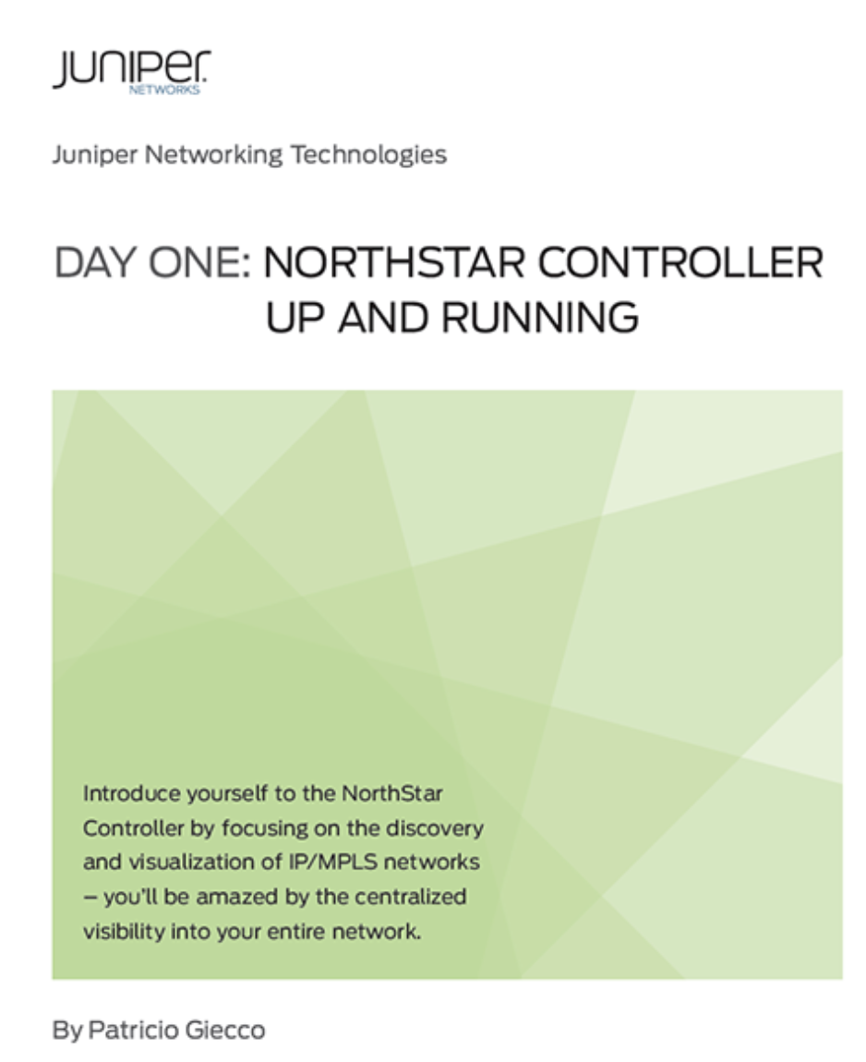
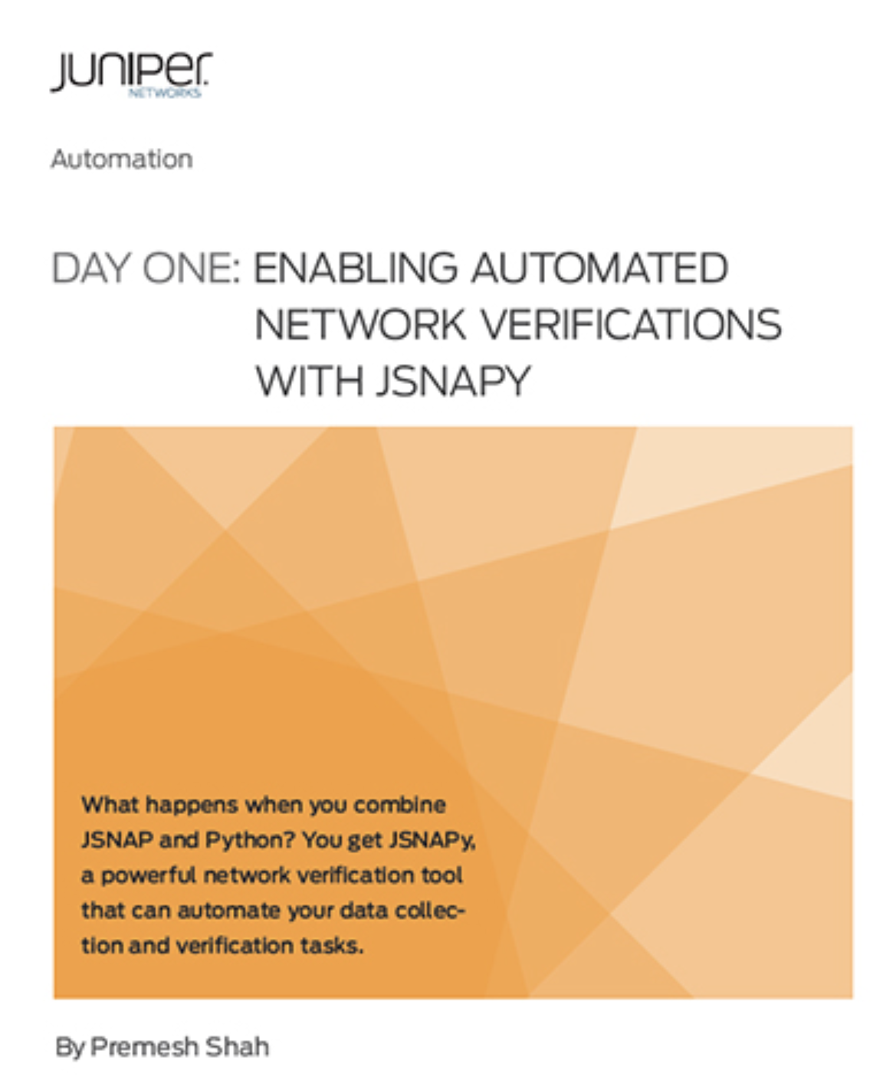

Other Sources
Need a lot of resources
and vendor license
Silvia Murgescu
Email: silvique_ms@yahoo.com

Slide 8










ICONS
Third party product virtually running any Juniper software
L2-L3 Switch
Folder
Open Folder
Scripts
Ideas
vMX
vSRX
Network
Automation
Juniper Virtual Products
Use yellow glow for VIRTUAL PRODUCTS ONLY
Network Lines are 1.5pt line weight
Juniper Logical Router
Laptop
Generic Server
Female Behind
Command Line Interface
Wireless Laptop
Network Cloud
Juniper L2-L3 Switch
Wireless Gateway
Network Cloud
Northstar Controller
Contrail Controller
Contrail vRouter
Junos Telemetry Interface
Silvia Murgescu
Email: silvique_ms@yahoo.com

Slide 9
Sky
Lifter

